Slide 1
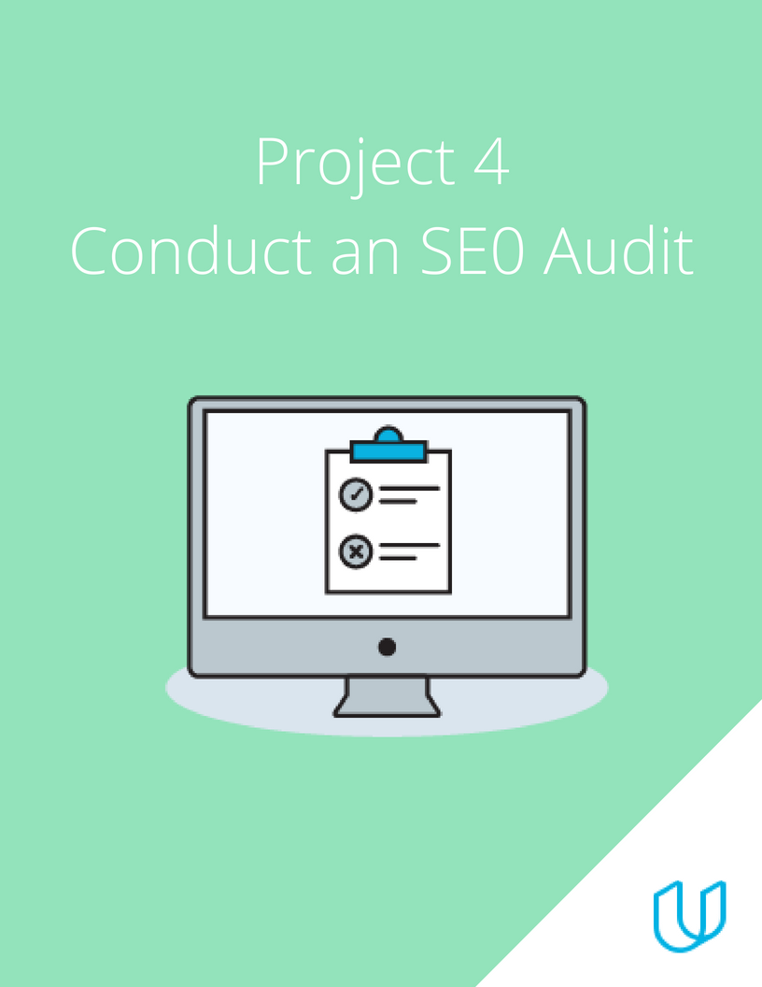
Project 4: SEO Audit

Slide 2
Marketing Objective & KPI
Marketing Objective - Increase website visit by 25% over 4 months by optimizing organic search and improve the site ranking above other competitors sites
KPI - Number of click through rate (CTR) in 4 months

Slide 3

Target Persona
Background and Demographics | Target Persona Name | Needs
Female, 26 yrs old Not married Fashion designer Interested in technology,that where the world is heading towards ₦500,000 annually Bsc degree | Olatunji Glory Tomisin | Would like to learn about digital marketing. Would like to get connected to industry for freelancing options Would like to earn a credible certificate from digital marketing Meet the digital world requirement
Hobbies | Goals | Barriers
Travel,dressmaking Love to sing Like to read and be involved with women empowerment Designing | To expand my business and move it to the next level Be able to apply digital marketing to my business Learn digital marketing and earn credible degrees outside of my field of study. Better management | Work load is much and hence time is premium Lack of proper equipment to start course like laptop and premium data Little knowledge in technology Lack of time

Slide 4
Part 2
On Site SEO
Audit

Slide 5
Keywords
 | Head Keywords | Tail Keywords
1 | Udacity marketing | Udacity digital marketing nanodegree
2 | Digitalmarketing | Udacity digital marketing nanodegree review
3 | Udacity digital marketing | Udacity online digital marketing nanodegree
4 | Digital marketing udacity | Udacity digital marketing nanodegree course
5 | Udacity nanodegree | Udacity digital marketing nanodegree program

Slide 6
Keyword with the Greatest Potential
Which Head Keyword has the greatest potential?
Udacity marketing
Explanation:this keyword has 346 monthly search with ranking difficulty of 46. This shows that there is opportunity for udacity to rank on page 1.
Which Tail Keyword has the greatest potential?
Udacity Digital marketing nanodegree.
Explanation: This long tail keyword has 252 monthly search and a keyword ranking difficulty of 40. This makes it the ideal long tail keyword target.

Slide 7
Technical Audit: Metadata
Perform a technical audit on the metadata. Create a table, like below, to enter the current metadata for the DMND page and your proposed revisions. Make sure to do this for 5 Alt-Tags, so there are 5 tables in total.
URL:https://www.udacity.com/course/digital-marketing-nanodegree--nd018 ss
Current
Title Tag | <title>Digital Marketing Course Online</title>
Meta- Description | <"description" content="Take Udacity's digital marketing course online. You will learn SEO, SEM, Google Ads, Email Marketing and Affiliate tactics to maximize traffic and improve online visibility.">
Alt-Tag | Digital Marketing Course Online

Slide 8
Technical Audit: Metadata
Perform a technical audit on the metadata. Create a table, like below, to enter the current metadata for the DMND page and your proposed revisions. Make sure to do this for 5 Alt-Tags, so there are 5 tables in total.
Revision
Title Tag | Learn Digital Marketing Online(Udacity Nanodegree) 7-days trial
Meta- Description | Join the digital marketing online course to learn marketing strategies that will help you improve your business performance, secure a good job and start a new career.
Alt-Tag | Udacity Digital Marketing course online

Slide 9
URL: https://www.udacity.com/course/digital-marketing-nanodegree--nd018
Alt-tag #1
Current | <img src="//www.udacity.com/www-proxy/contentful/assets/2y9b3o528xhq/2LTRZIjRPDODMAvOUSJIDp/abf71ea75db832dd997f33c165f1d974/sticker-desktop-update.png" alt="NEW Personalized Discounts! Learn more.">
Replacement | <img src="//www.udacity.com/www-proxy/contentful/assets/2y9b3o528xhq/2LTRZIjRPDODMAvOUSJIDp/abf71ea75db832dd997f33c165f1d974/sticker-desktop-update.png" alt="Digital Marketing Nanodegree Personalized Discounts! Learn more.">
Alt-tag #2
Current | <img alt="Play Video" src="//www.udacity.com/assets/iridium/images/nanodegree-overview/shared/nd-hero-video/icon-video-white.svg">
Replacement | <img alt=”Digital Marketing Nanodegree introduction video” src="//www.udacity.com/assets/iridium/images/nanodegree-overview/shared/nd-hero-video/icon-video-white.svg">

Slide 10
Technical Audit: Alt-tags
URL: https://www.udacity.com/course/digital-marketing-nanodegree--nd018
Alt-tag #3
Current | <img src="//www.udacity.com/www-proxy/contentful/assets/2y9b3o528xhq/753EFF3UhcMMUythiZIOoc/c7daef06c3876eddf8ecaa01026f1d46/career.svg" alt="Career services">
Replacement | <img src="//www.udacity.com/www-proxy/contentful/assets/2y9b3o528xhq/753EFF3UhcMMUythiZIOoc/c7daef06c3876eddf8ecaa01026f1d46/career.svg" alt="Digital marketing nanodegree Career services">
Alt-tag #4
Current | <img class="wordmark_logo__2xZEi" src="/images/svgs/udacity-tt-logo.svg" alt="Udacity">
Replacement | <img class="wordmark_logo__2xZEi" src="/images/svgs/udacity-tt-logo.svg" alt="Udacity logo for Digital Marketing Nanodegree Program">

Slide 11
Technical Audit: Alt-tags
URL: https://www.udacity.com/course/digital-marketing-nanodegree--nd018
Alt-tag #5
Current | <img src="//www.udacity.com/www-proxy/contentful/assets/2y9b3o528xhq/RTryNFr1PDDx4cfQEkH6e/d5a05edf4c696f9553f5a6df7fca9dd6/icon-finance.svg" alt="">
Replacement | <img src="//www.udacity.com/www-proxy/contentful/assets/2y9b3o528xhq/RTryNFr1PDDx4cfQEkH6e/d5a05edf4c696f9553f5a6df7fca9dd6/icon-finance.svg" alt="flexible payment available for udacity digital marketing nanodegree program">

Slide 12
TO GET HOW STARTED IN DIGITAL MARKETING
Why the keyword: I choose the keyword to help the target audience understand what digital marketing is all about.
the aim of the article is to provided the target audience with highlight of online degree courses(including DMND) I will talk about how Digital Marketing Nanodegree is very credible and insightful which is developed in association with the likes of Google and other leaders in the digital marketing space and I will also like my target audience to know how DMND offers a real-world experience, and how it is easy to learn from the comfort of people's homes.
the next paragraph of the article will discuss the online degree courses making more emphasis on Udacity digital marketing nanodegree, I will also mention about time, commitment and cost .
I will mention the expected outcome of each nanodegree program, career growth, knowledge and experience
INTRODUCTION: There are numerous online digital marketing course today, accessible to all from different part of the world
when choosing an online platform to start your career i would recommend UDACITY to the target audience for instance a

Slide 13
HOW TO GET STARTED IN DIGITAL MARKETING (CONT’)
Recent graduate with no knowledge about what digital marketing is all about would be taught about content writing, Facebook campaign,
and search engine optimization and that is to mention a few.
WHY WILL IT WORK: what makes an article or a blog reliable is that it provides answers to the lingering question and provides solution to aid in their decision making, we have audience that search websites that will give them what they are searching for.

Slide 14
WHY DIGITAL MARKETING COURSE IS NEVER A WASTE OF TIME
KEYWORD : Best digital marketing course
I would like to start with how fast everything is evolving and we can’t get past digitalization, also jobseekers and their qualifications. If you feel you should reinvent yourself, but don’t know what direction you should be heading (yet), a digital marketing course is always a safe choice. You can apply this knowledge in every sector! And while deciding on which course or platform to choose, I will point the target audience towards Udacity DMND by pointing them directly to the dedicated page on the Udacity-website. To enforce my post, I will gather testimonials from students (by Udacity) and deliver an extra link . Claiming you are the best is only credible if you compare with competitors, so I will point out the extra’s that DMND has to offer.
INTRODUCTION: Digital marketing is the heart of technological advancement in our society today, which is the channel through which information is been disseminated to various audience. Marketing is the art of consistently reaching the target audience with the right products, therefore the combination of both digital and marketing allows us to use digital channels to reach our target audience with the right product and services.

Slide 15
CON’T
WHY THIS WOULD WORK: digital marketing is very broad and exhaustive and it touches every aspect of marketing talking about search engines, backlinks, page ranking and the likes, Udacity is the place for all this and is never a waste of time which is also good ,what do they say about an idle mind.

Slide 16
KICKSTART YOUR BLOG THROUGH SOCIAL MEDIA
KEYWORD: Social Media
This post shares the obvious advantages of using Social Media to attract more visitors to your blog. If you want to know what goes on behind the scenes of advertising on social media, a profound extra training can create clarity and can give you more confidence in that matter. Readers are introduced to Udacity DMND as an overall 360-degree training that will cover all necessities they need to launch a social media campaign, tailored to their blog and budget. This blog post will contain many relevant keywords and of course a link to the Udacity DMND page, links to my own Facebook and Instagram account and other interesting blogs about the topic.
INTRODUCTION: The term Social media marketing provides companies with a way to engage with existing customers and reach new ones
WHY THIS WOULD WORK: We leave in a world where everyone one wants to do it yourself (DIY) after going through the Udacity digital marketing nanodegree program it can help their decision making. Also this article should lead to increase in signup as this would be a stepping stone in starting their career

Slide 17
Technical Audit: Backlink Audit
Using the Moz OpenSite Explorer tool, perform a backlink audit on the webpage you have chosen. These 3 backlinks need to have a DA score of 97-100. Note: If you are doing the DMND challenge, perform this exercise on Udacity.com.
 | Backlink | Domain Authority (DA)
1 | http://www.cloudflare.com/en-in/case-studies/udacity/ | 98
2 | http://developer.mozilla.org/zh-CN/docs/Web/JavaScript/Reference/Global_Objects/Promise | 98
3 | http://xd.adobe.com/ideas/career-tips/online-ux-design-courses-bootcamps/ | 97

Slide 18
Link-Building
Using the SEMRush or SE Ranking tool and research, strategize a link-building campaign.
Identify three websites that you think would be relevant, high traffic sites that you would like to gain backlinks from to help drive traffic to Udacity’s or your company’s page.
Site Name | Access Bank
Site URL | https://www.accessbankplc.com/
Organic Search Traffic | 1.29k
Site Name | Bit Degree
Site URL | Bitdegree.org
Organic Search Traffic | 448.4k
Site Name | businessinsider
Site URL | Businessinsider.com
Organic Search Traffic | 433.4k

Slide 19
Site Performance Audit: Performance Tests
For each of the submissions, please take a screenshot of your results and post your screenshot on your submission presentation.
Using the Northcutt or any other tool, research how many of Udacity’s website or your company’s pages are indexed by Google.
Using the Google Page Speed Insights tool, perform a speed test of udacity.com’s or your company’s mobile presence.
Using the Think with Google tool, assess the mobile-friendliness of the udacity.com site or your company’s website.

Slide 20
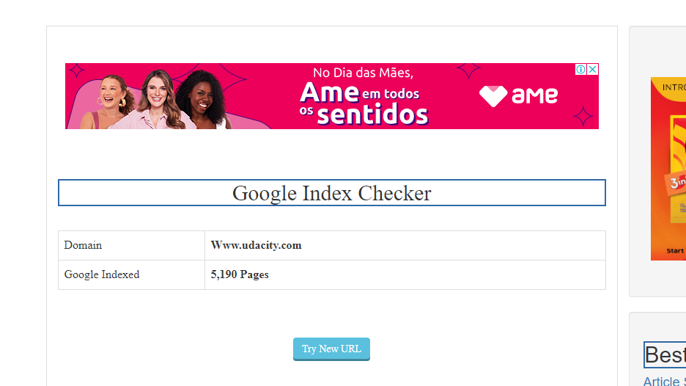
Page Index
Using the Northcutt or any other tool, research how many of Udacity’s or your company’s website pages are indexed by Google.
The number of pages indexed by search engine shows the page crawlable by the search engine. For search engine to drive traffic to a site it must be indexed, th more number of pages indexed the probability of search engine to find your content.

Slide 21
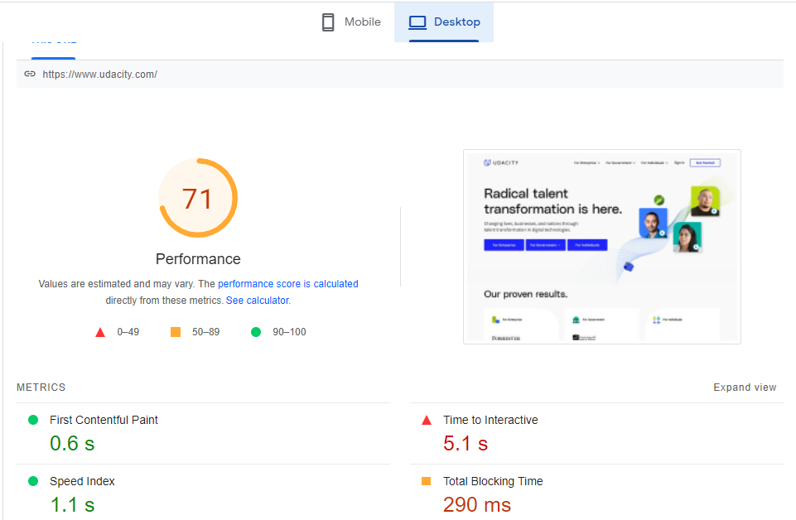
Page Speed
Using the Google Page Speed Insights tool, perform a speed test of udacity.com’s or your company’s website’s mobile presence.
Google uses site speed in its algorithms as one of the parameters for ranking search result, therefore improving page speed will improve page ranking. Which leads to better conversion rate.

Slide 22
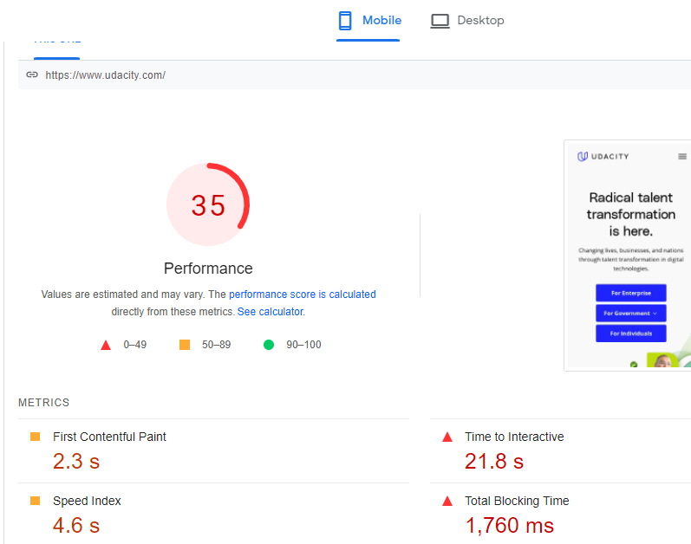
Page Speed
Using the Google Page Speed Insights tool, perform a speed test of udacity.com’s or your company’s website’s mobile presence.
Google uses site speed in its algorithms as one of the parameters for ranking search result, therefore improving page speed will improve page ranking. Which leads to better conversion rate.

Slide 23
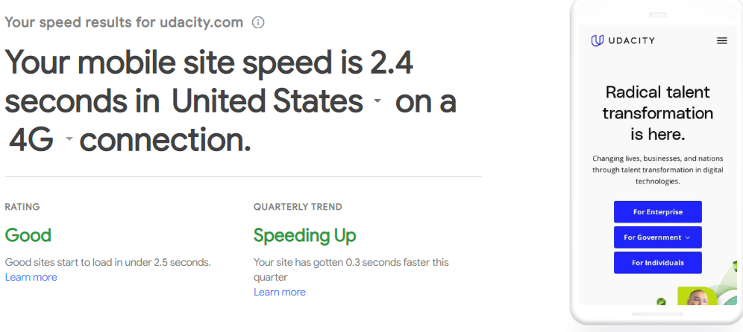
Mobile-Friendly Evaluation
Using the Think with Google tool, assess the mobile-friendliness of the udacity.com website.
Most people today use their mobile phone for search. Google makes use of “mobile friendliness” as one of the parameters for search engine algorithms.

Slide 24
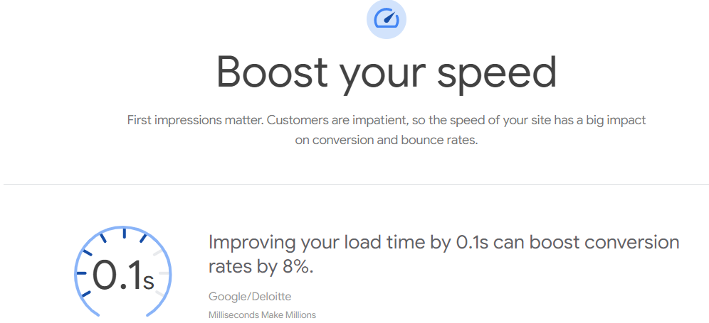
Mobile-Friendly Evaluation
Using the Think with Google tool, assess the mobile-friendliness of the udacity.com website.
Most people today use their mobile phone for search. Google makes use of “mobile friendliness” as one of the parameters for search engine algorithms.

Slide 25
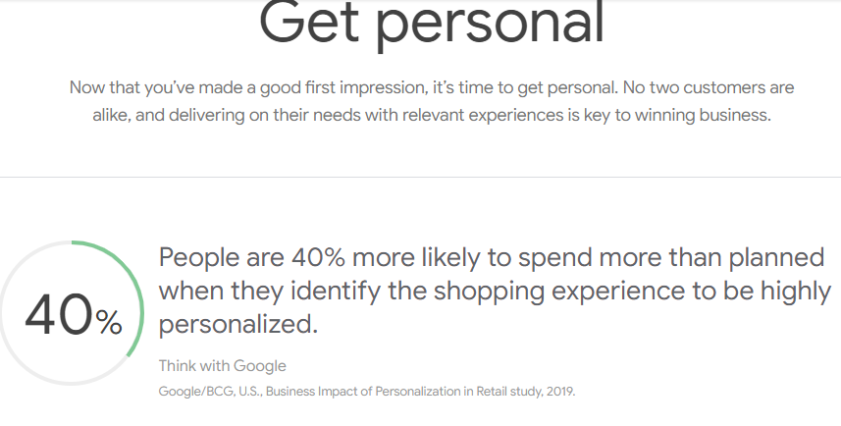
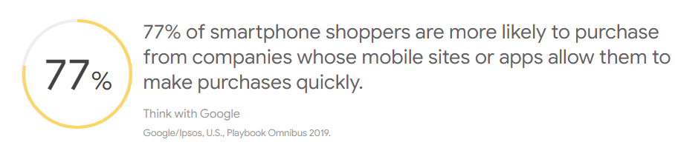
Mobile-Friendly Evaluation
Using the Think with Google tool, assess the mobile-friendliness of the udacity.com website.
Most people today use their mobile phone for search. Google makes use of “mobile friendliness” as one of the parameters for search engine algorithms.

Slide 26
Recommendations
ONSITE SEO AUDIT
While conducting my onsite audit using the MOZ keyword explorer tool, I took note of what little information that is contained on the digital marketing nanodegree program page. There should be information that would satisfy the researchers needs and the users experience, the purpose of the onsite SEO audit is to suffice the gap in your content that you can address and improve your ranking on the search engine result page.
In other to increase the numbers of clicks on the DMND program website I will update the headline, frequently asked questions (FAQ), the testimonials and the landing page content.
OFF-SITE SEO AUDIT
The off-site SEO audit has to do with links, which are essential for users navigation on the website and for search engines to find content. Backlinks has to do with incoming links and inbound links, and search engines believes that several links pointing to your website is similar to many people saying we are important.
To improve the offsite SEO of Udacity DNMD program website and to help build up buildup traffic from external

Slide 27
Recommendations
websites I will advise,
- publishing content that talks about Udacity digital marketing nanodegree program on all social media platforms
- I will also recommend guest blogging which is an SEO strategy in which bloggers would write an article about Udacity DMND program thereby building broader audiences and creating backlinks.
TECHNICAL AUDIT
Meta Tags: is a way of guiding search engine without interfering with users experience. It has little description of meta tads and that can be improved
Alt Tags: describes the picture or video of a website during technical audit alt, and there was no description for the Alt tag title .it needs to be improved.
PERFORMANCE TESTS
The mobile-friendliness of Udacity DMND program page is slow to open on a mobile phone because on the tool think with google it shows 2.4 seconds on the mobile phone we can improve this by resizing the images on the website, this will boost the speed level on the mobile phone.

